Slide 1
Bulky
https://bulky.b4a.app/

Slide 2
Introduction
Thato

Slide 3
Introduction
Problem Statement : As students ourselves we have realized that food prices have gone up due to inflation caused by covid 19 .So many students have difficulty affording some basic needs as well as groceries that will at least last them for an entire month or two. Also, the lack of wholesalers close by campus makes it impossible for students to access large quantities(bulk) products that surely last them for extended periods as well as save them money along the way.
Solution : To create an app as a platform for varsity students to buy groceries in bulk, the groceries will be bought from the wholesalers with lower prices, then distributed amongst the students. The App will allow students to register their account with their basic information, have a wallet where they can load their balances then select food items and toiletries they want to the total of their balance. Then once a month the food items will be bought from wholesalers with lowest prices then deliver to the respective students to the respective residences.
Benefits of Solution:
Reasonable prices
Increased buying power
Large quantity of products
Convenient
Easy price comparison

Slide 4
System Architecture
Ofentse

Slide 5
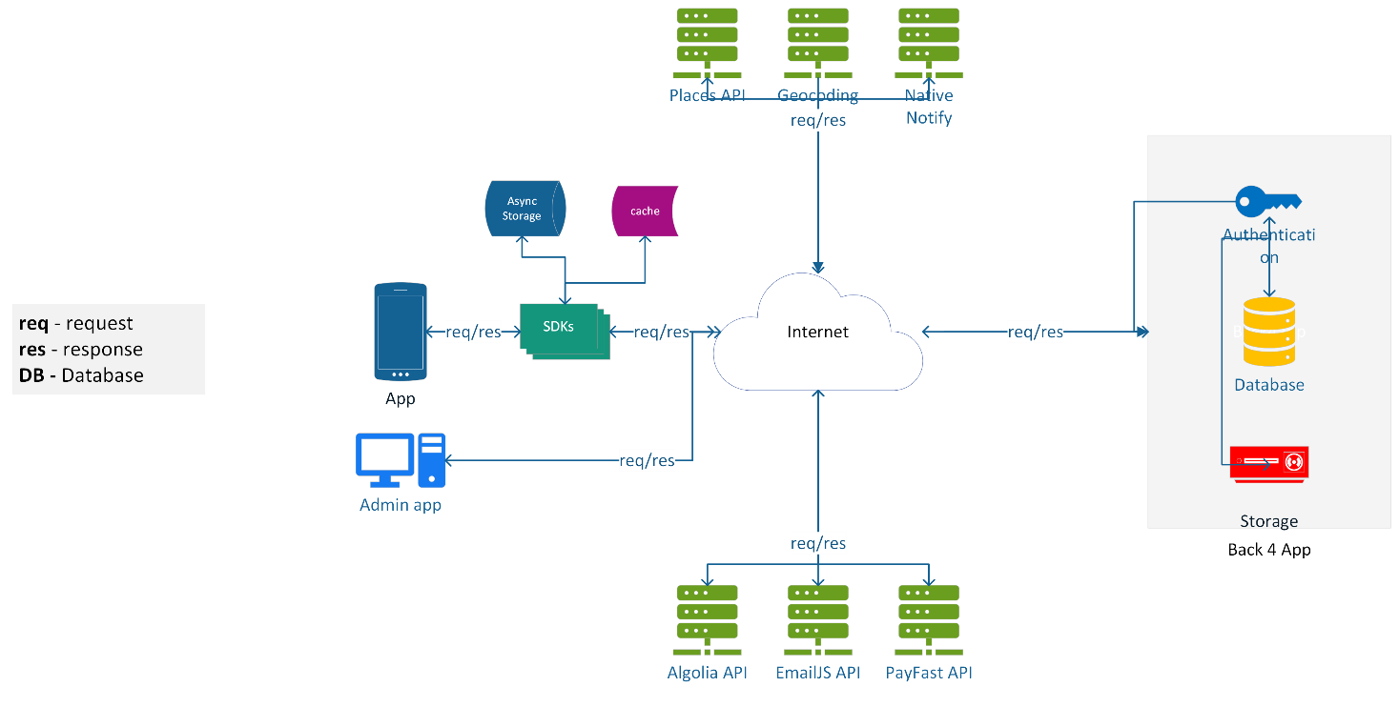

Slide 6
Use Case
Nesley

Slide 7
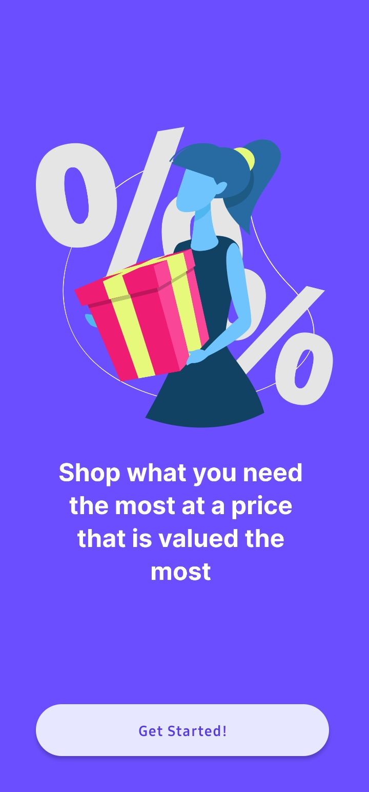
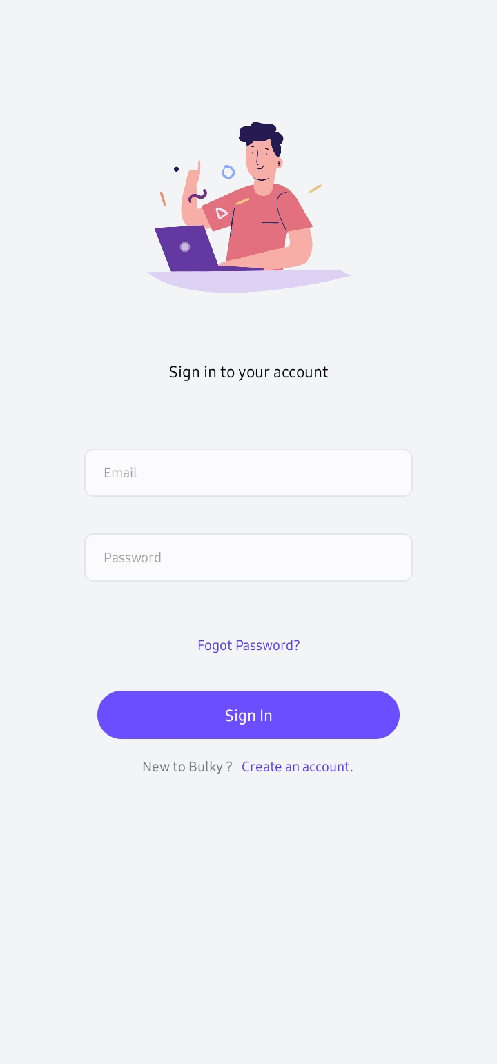
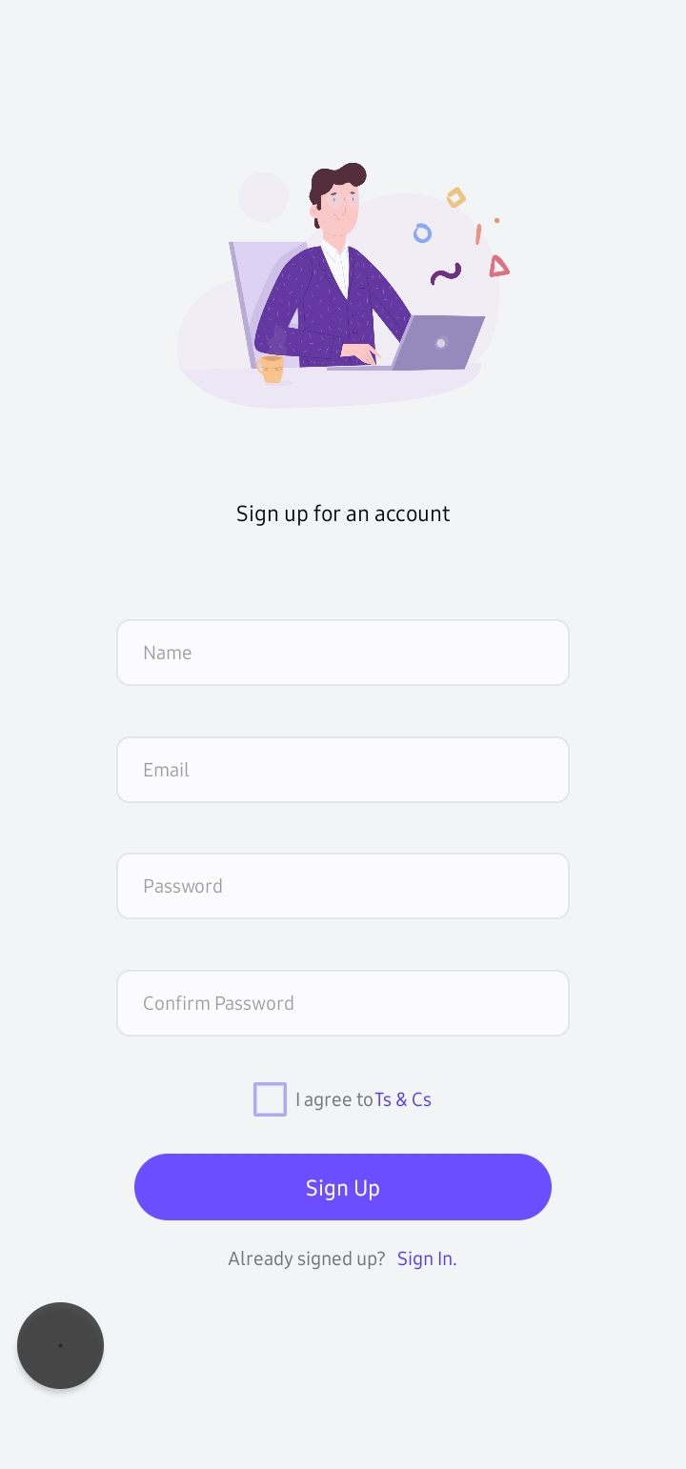
Welcome screens

Slide 8
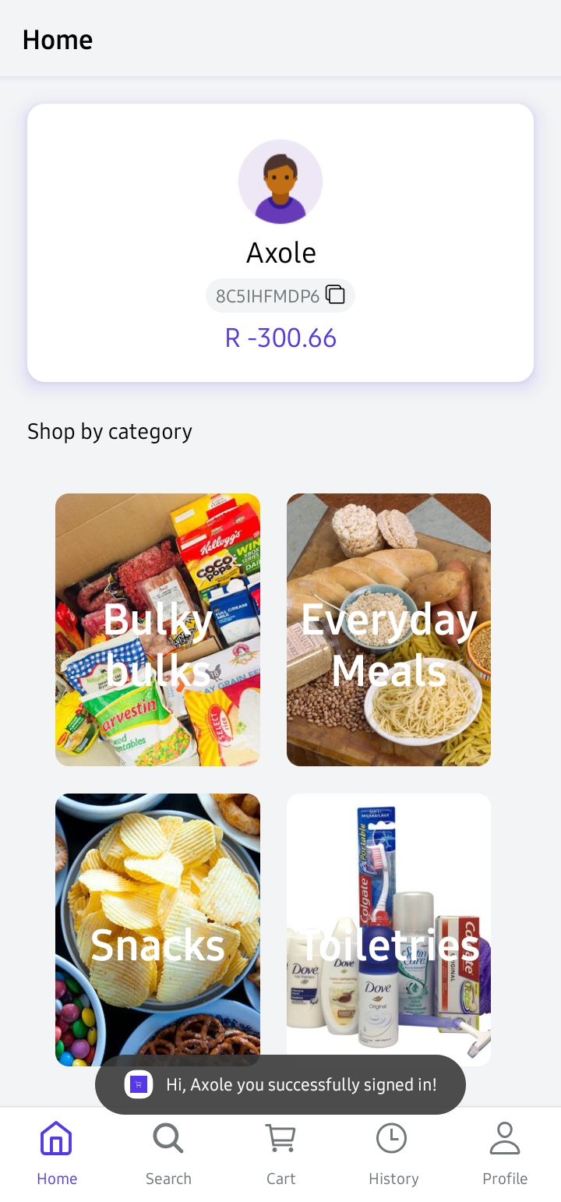
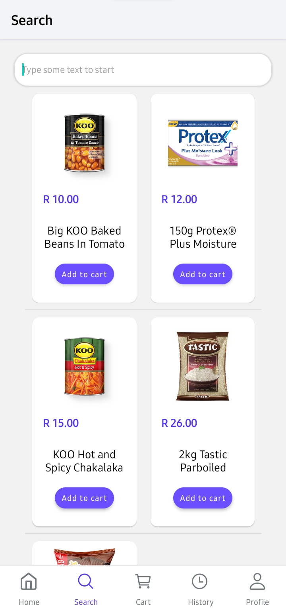
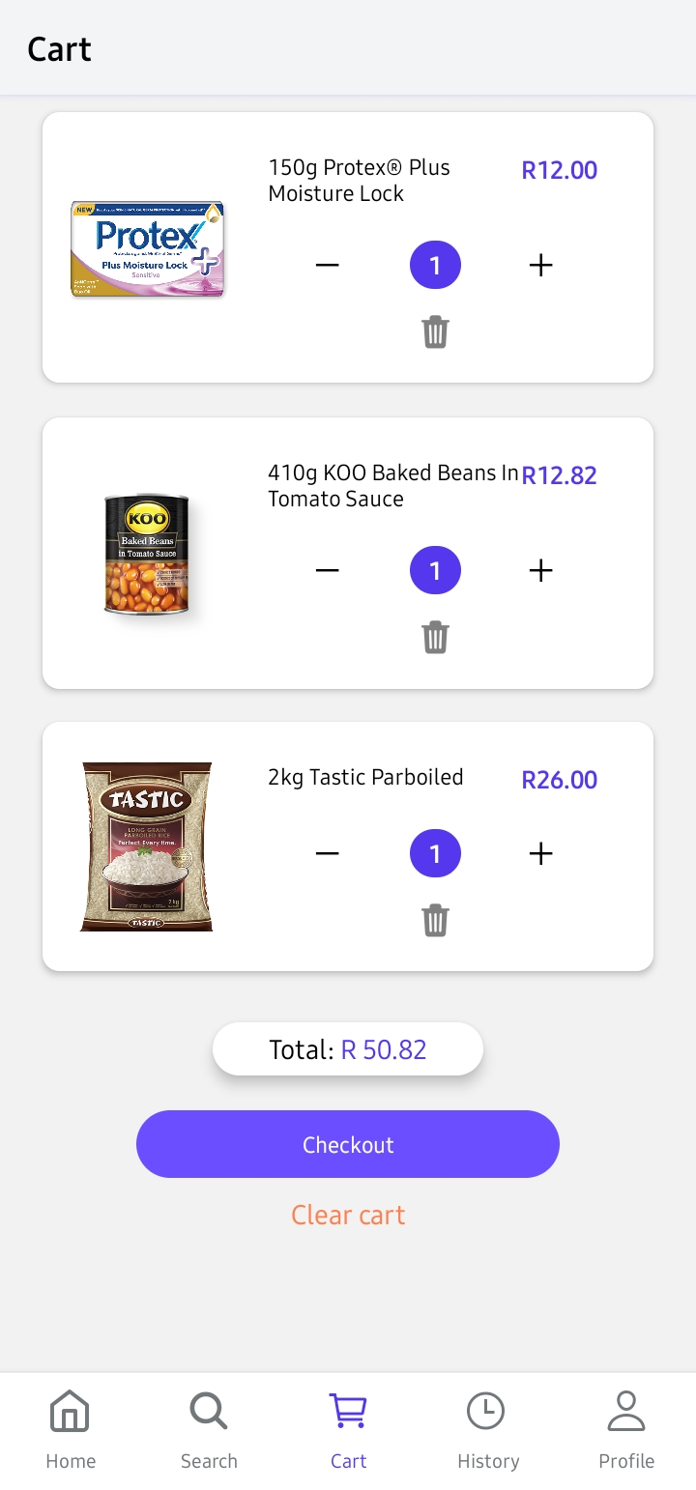
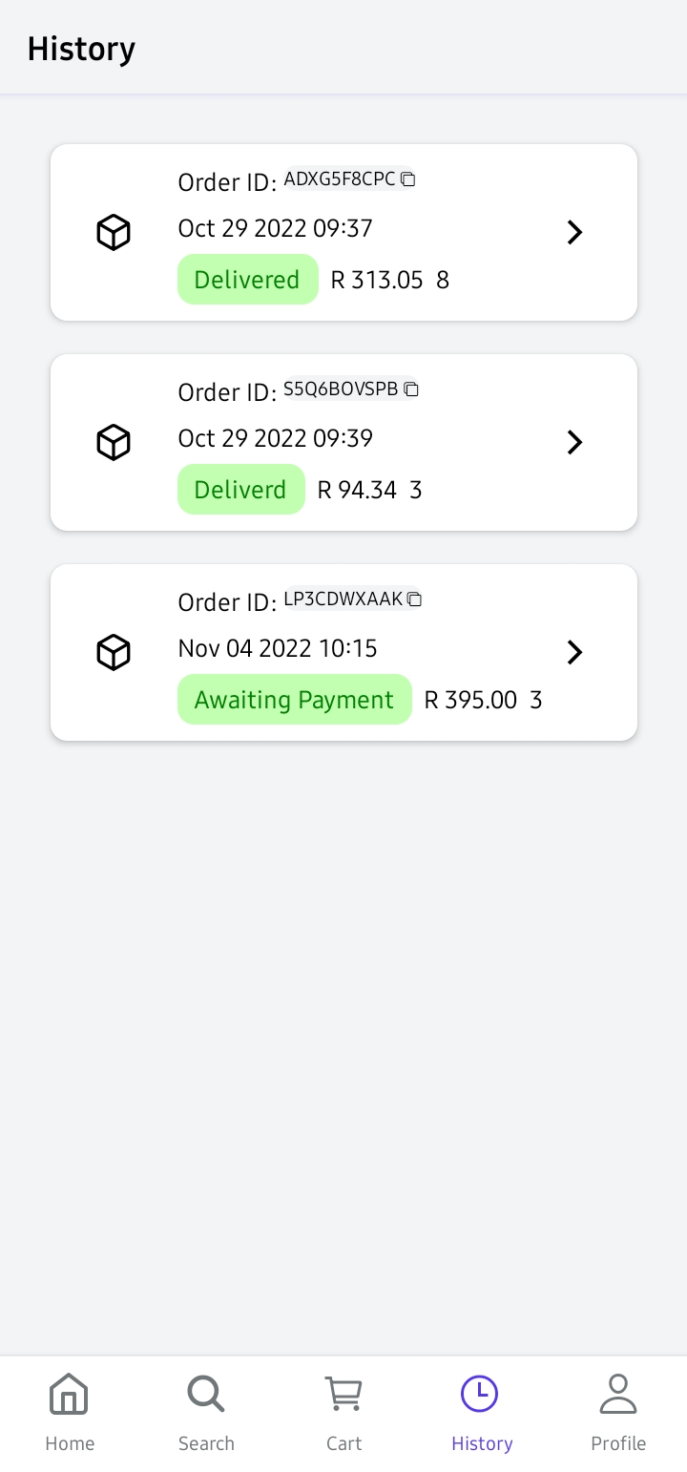
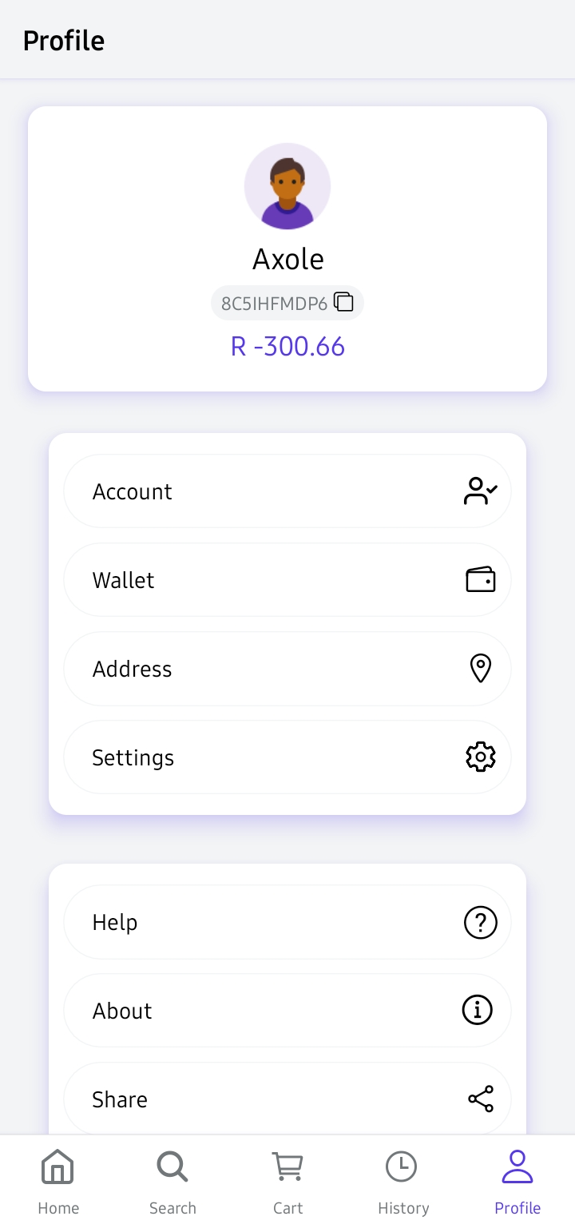
Tabs screens

Slide 9
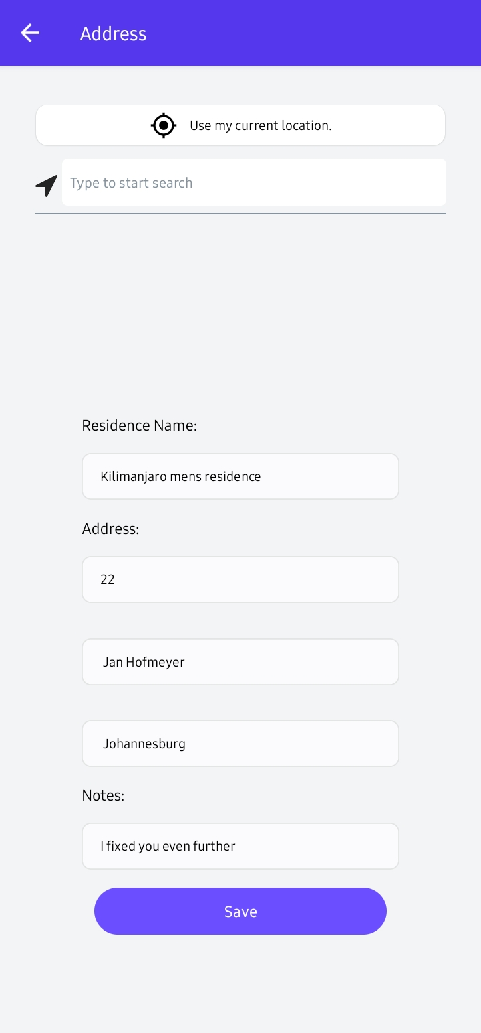
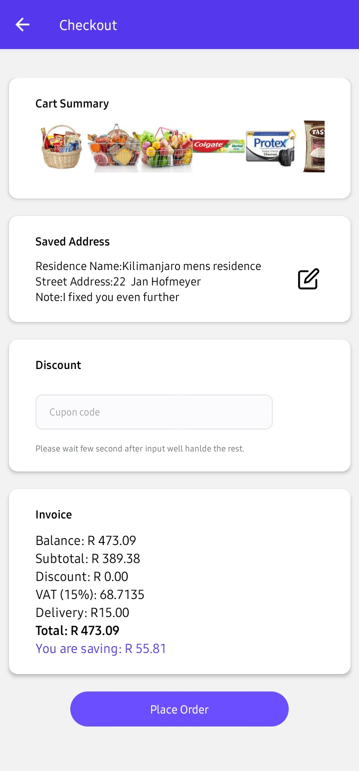
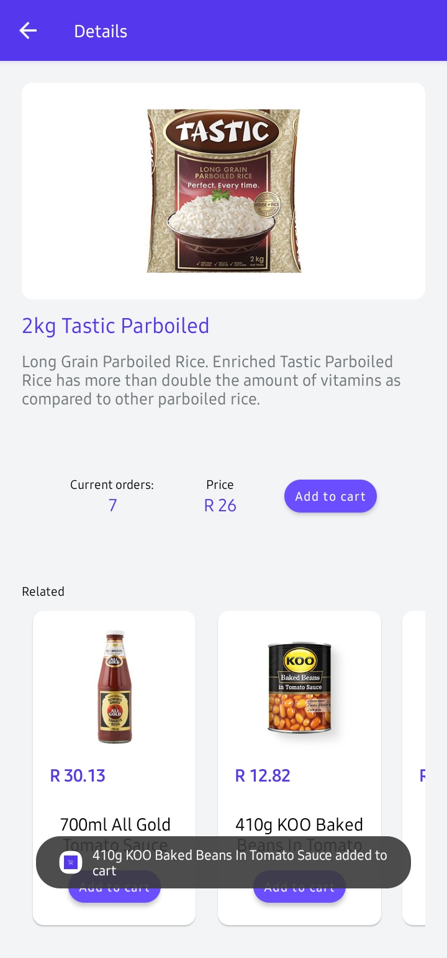
Other screens

Slide 10
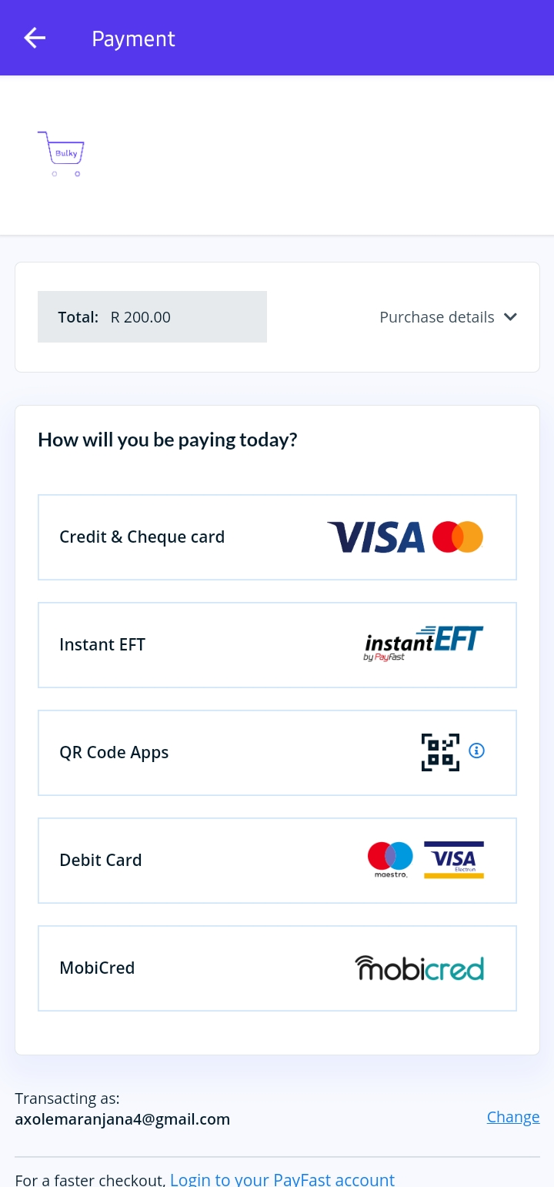
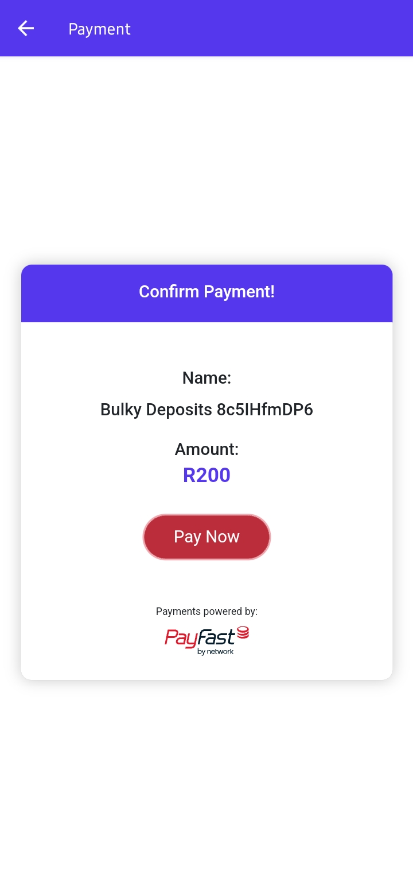
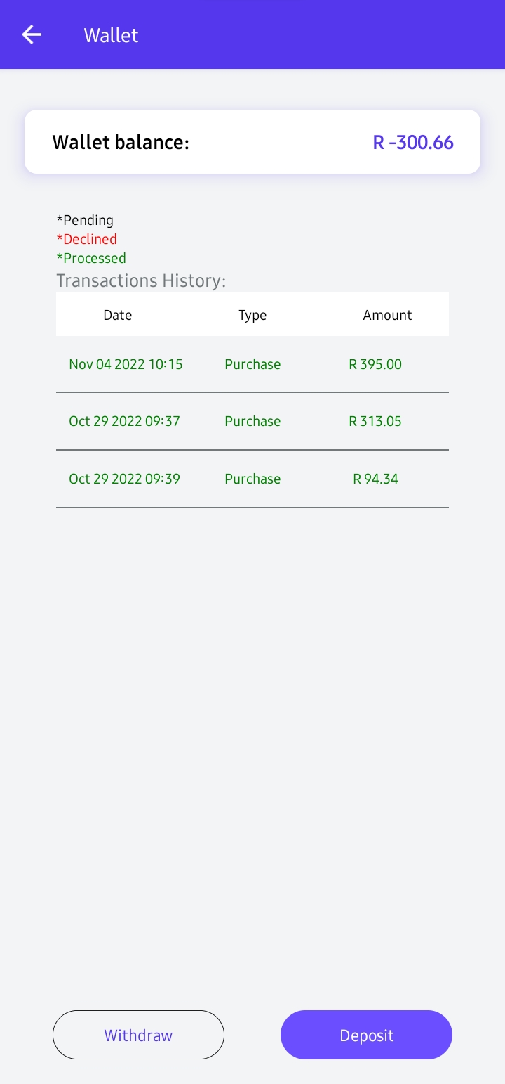
Payment screens

Slide 11
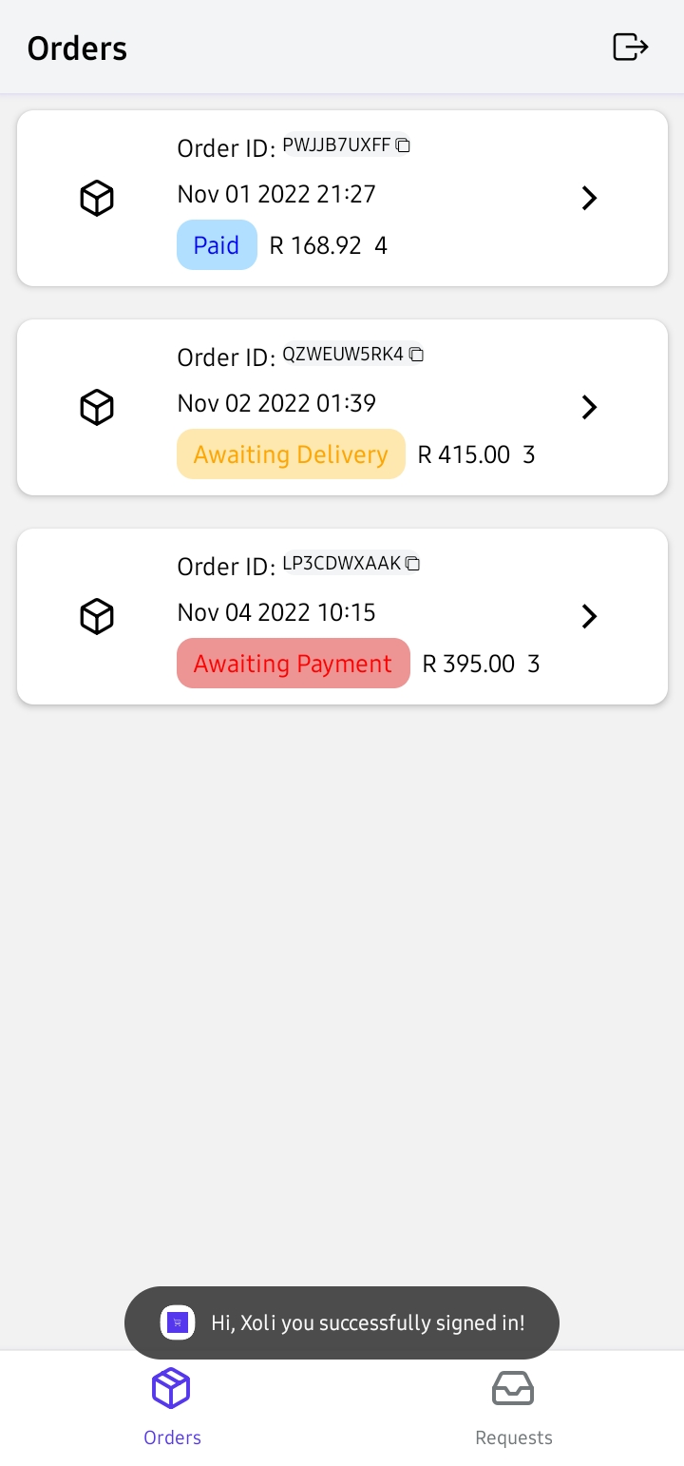
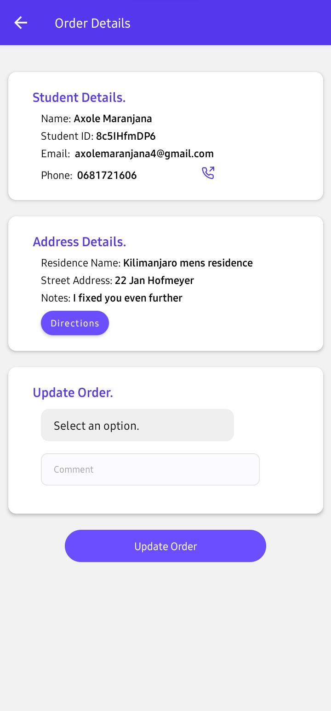
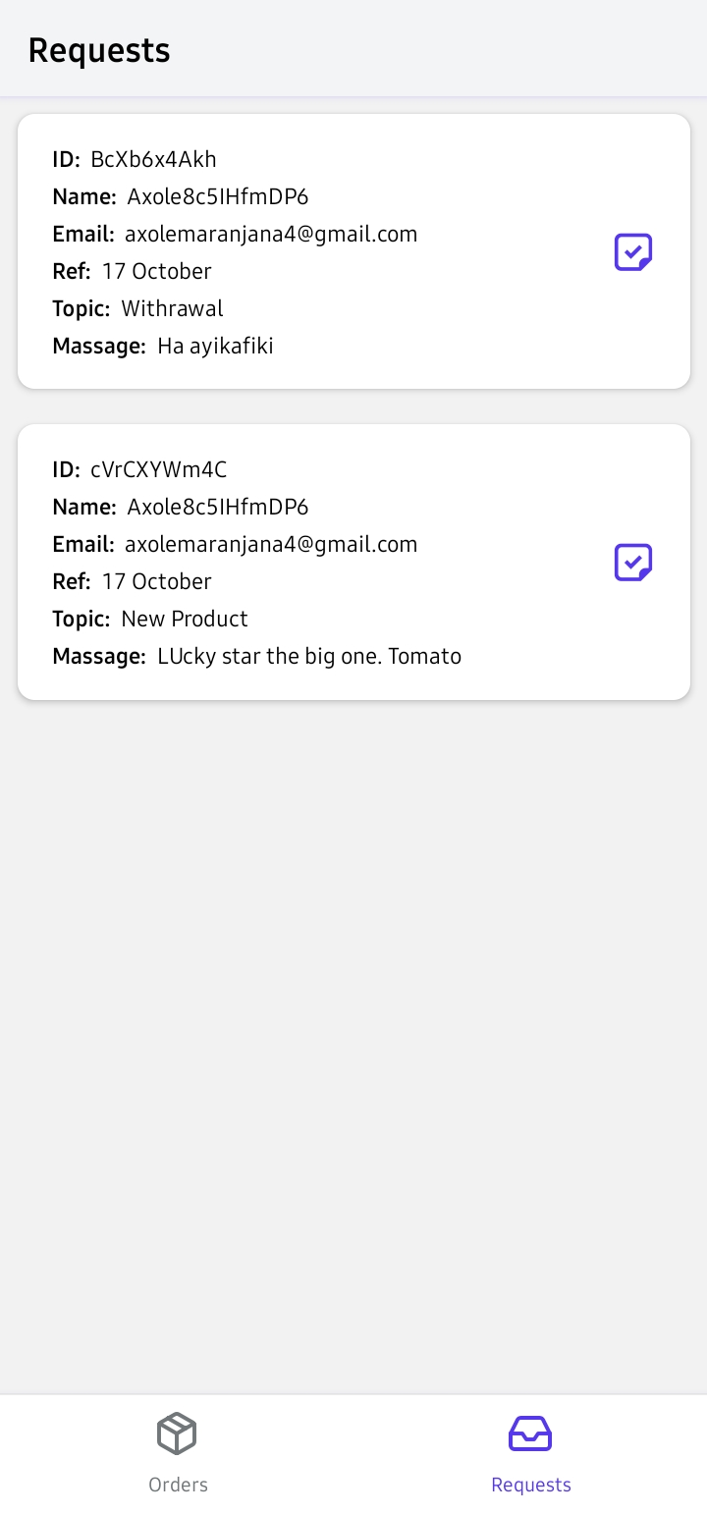
Admin screens

Slide 12
The Actual Solution
Michelle, Axole, Junior

Slide 13
Internet-based services / Device Support
React Native
Back4App Auth (Parse)
Back4App storage
Back4app Database (MongoBD)

Slide 14
CRUD
Bac4App database
AsyncStorage

Slide 15
Device Sensors/APIs
GPS
Sharing
Network
Clipboard
Notifications
Linking

